Slide 1
March 2023 | Food Service Report
Crawford Central School District

Slide 2
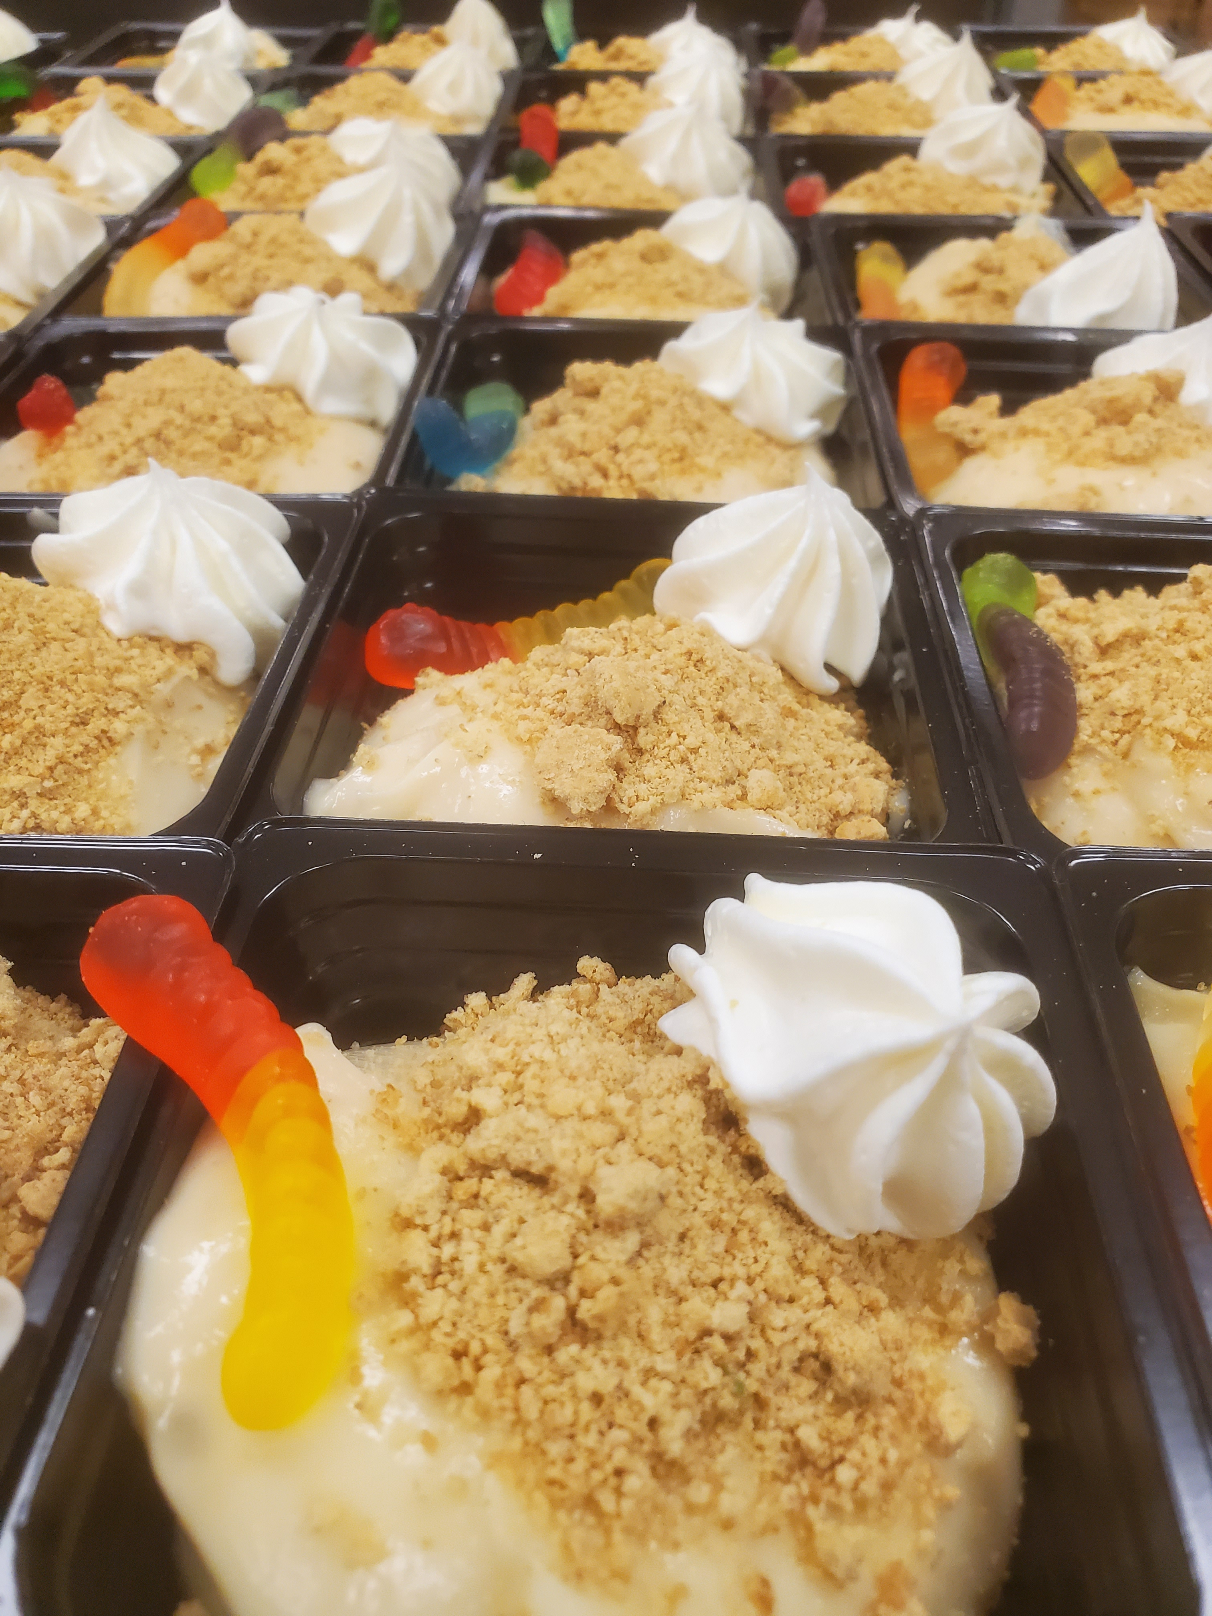
Post-Pandemic Impact on Participation
Participation Statistics
 | Budget | Actual
Breakfast | 1011 | 1343
Lunch | 1576 | 2019
Ala-Carte | 495.00 | 663.66

Slide 3
National School Breakfast Week
School Breakfast Program: Nutritious Start to the Day!
Cochranton Jr Sr High School students were invited to enjoy a fresh pancake breakfast on Monday, March 6th to kick off National School Breakfast Week. Of the 40 breakfast meals served, 16 students chose the pancake breakfast!

Slide 4
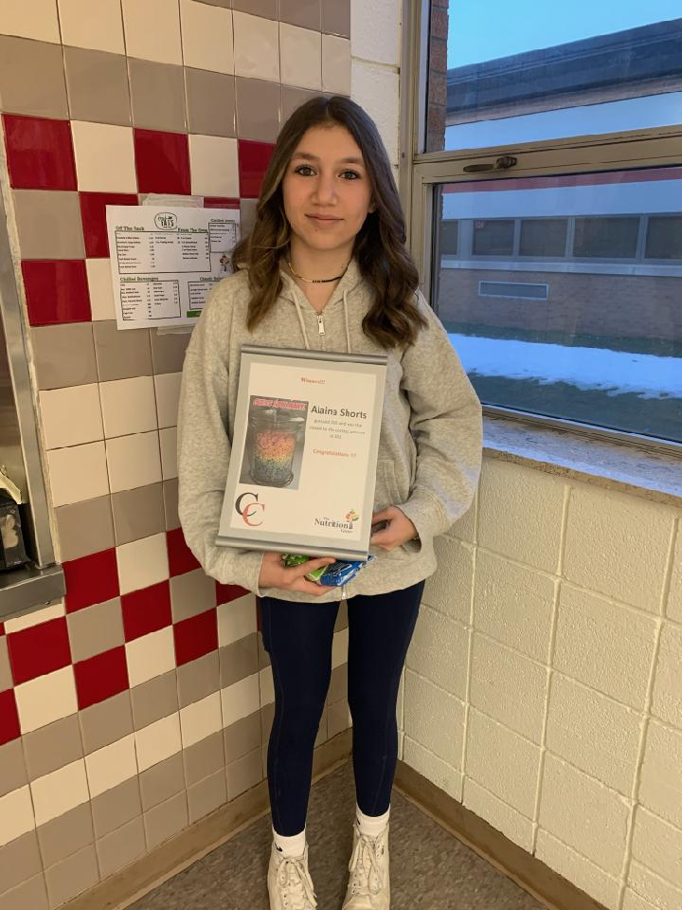
TNG On-Site at Crawford Central
National School Breakfast Week
Crawford Central School District student’s celebrated National School Breakfast Week during the week of March 6 through March 10. Elementary school students were invited to answer a daily riddle for a chance to win a Dirt Pudding Cup with their lunch each day! While Middle School and High School students competed to guess how many Fruit Loops were in a jar throughout the week with the winner earning $15.00 on their lunch account for snack room purchases!
Throughout the week the Crawford Central School District served 6,900 breakfast meals compared to the week of February 27 through March 3 when we served 6,700. The elementary schools served 4,808 of those meals and the secondary schools served 2,092 meals. Having the cereal jars located at the snack room counters during lunch for the students to place guesses in also gave the a la carte rooms a small boost in sales with a gain of $464.85 when compared to the previous week!
Play along and test your knowledge:
What does a pirate eat for breakfast?
What did the cheerleader bring her mom for breakfast on mother’s day?
What does a Snowman eat for breakfast?
What 2 things can you never eat for breakfast?
What does a mixed up hen lay?
1. Captain Crunch 2. Cheerio’s 3. Frosted Flakes 4. Lunch and Dinner 5. Scrambled Eggs

Slide 5
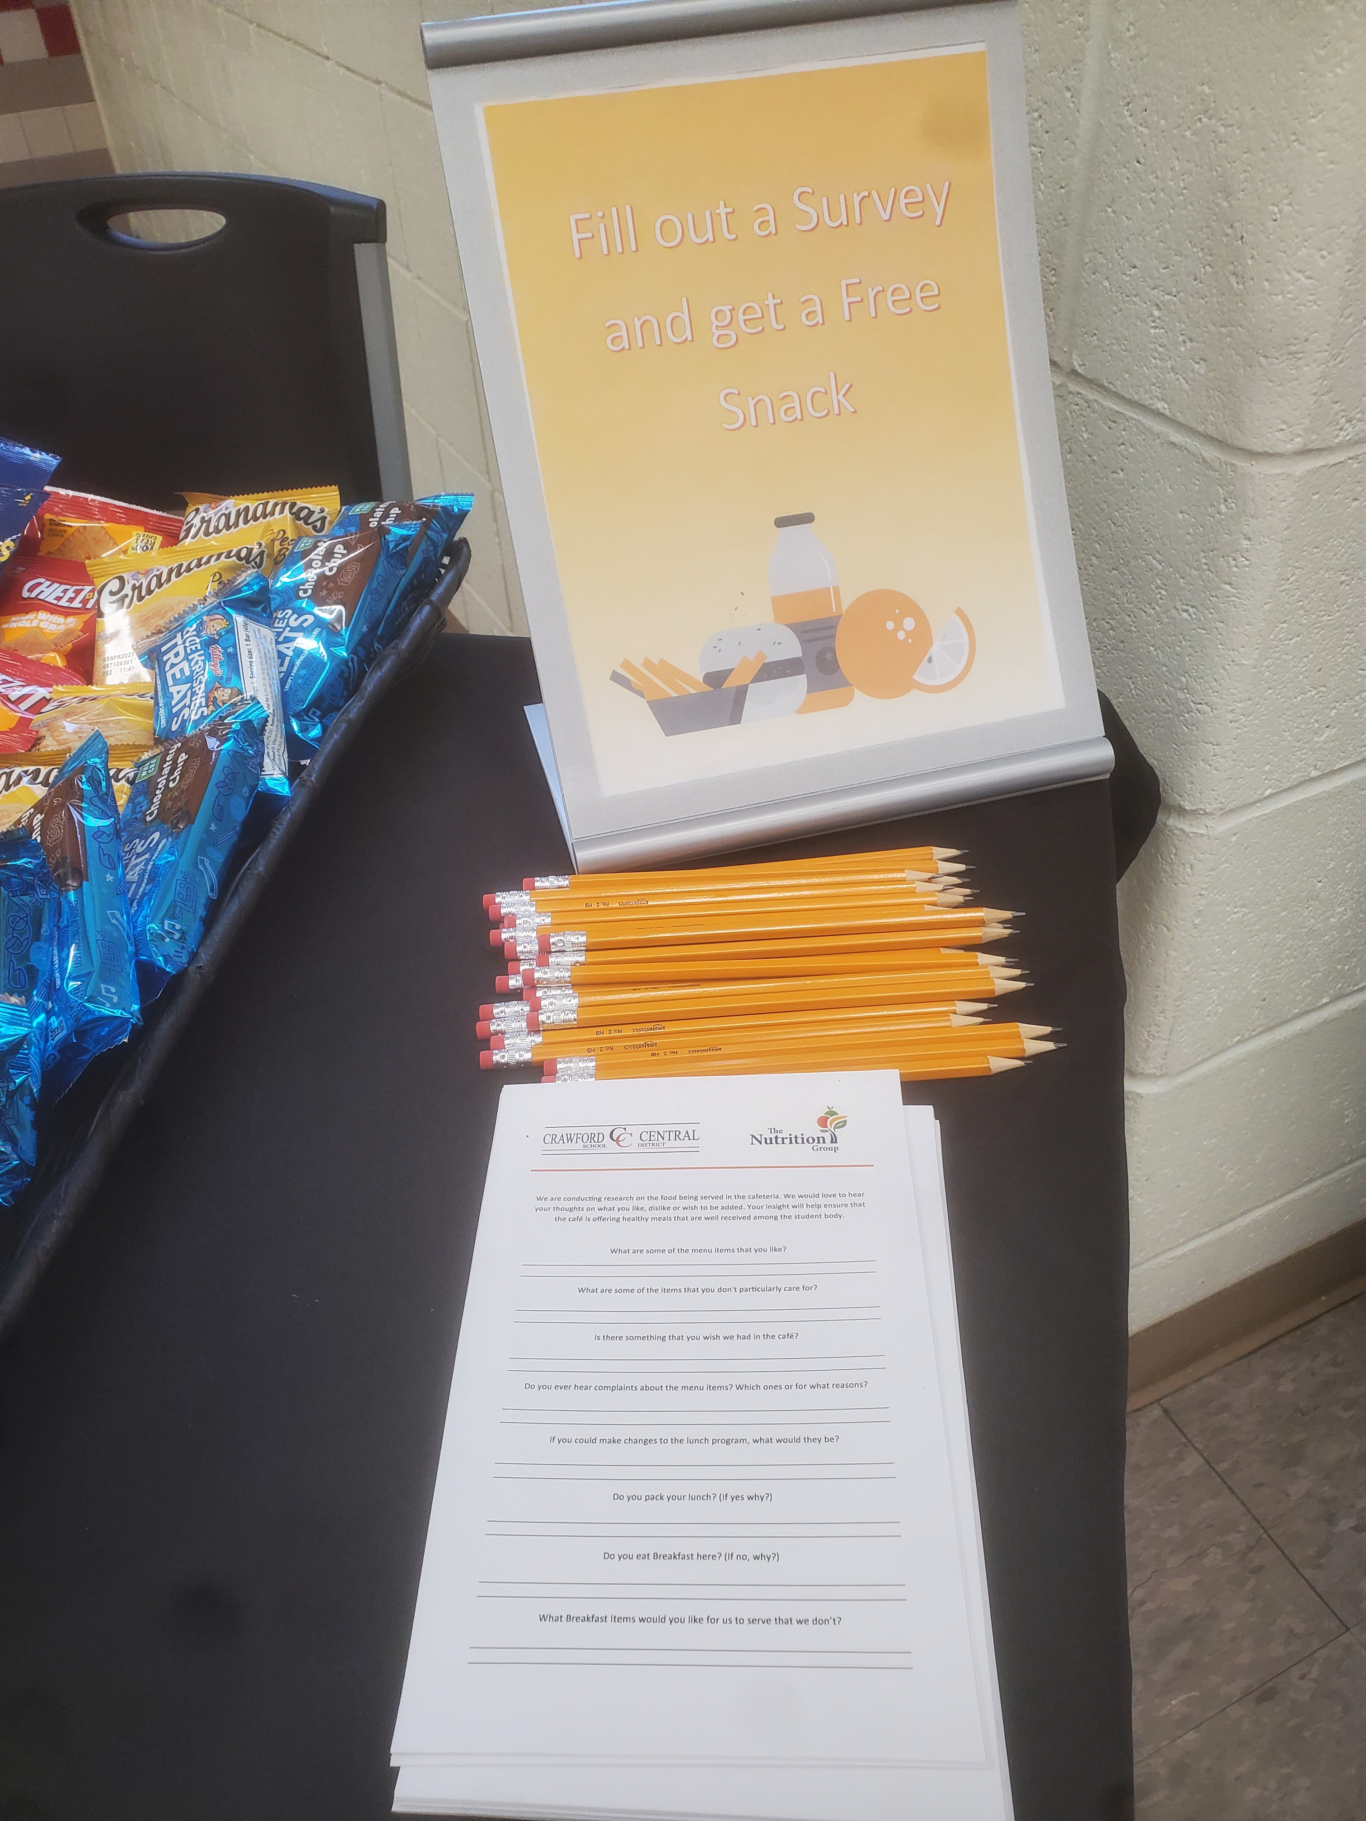
Student Survey at CJSH
Students at CJHS were invited to complete a survey of their likes and dislikes related to the school food program. The goal was to learn what we can provide to increase participation. In exchange for their response, students picked a free snack which helped us get double the responses we expected.

Slide 6
National Nutrition Month
Celebrating 50 Years during the month of March

Slide 7
Behind the Scenes from the USDA
Did you know TNG and your Director of Food & Nutrition order
USDA foods every year for your school?

Slide 9
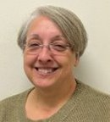
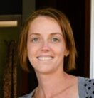
Thank You!
Your Food Service Team:
Tammy Groover
Food Service Director
814-336-1121 Ext. 130
tammy.groover@craw.org
crawford@thenutritiongroup.biz
Follow us on:
Travis Weese
Food Service Director
814-336-1121 Ext. 130
Travis.weese@craw.org
crawford2@thenutritiongroup.biz
@TheNutritionGroup
@TNG_Corporate
Katie Baldwin
Regional Manager
814-397-6696
kbaldwin@thenutritiongroup.biz
@TheNutritionGroup

